Slide 1
Senior Design Mid-Semester Demonstration Group 3(DPOV)
Philip Geramian, Alex Julian, Lyle Moffit, Roman Olesh
Syracuse University College of Engineering and Computer Science
February 26, 2015

Slide 2
3DPOV – General Overview
Proof of Concept
Goals for open house

Slide 3
3DPOV – Things done up to this point this semester
New Power Supply (270W)
New Hall Effect Sensor – Toshiba TCS20DPR
Electronic Speed Controller – 30A,40A
ESC controller upgrades – enclosure, knob, etc…
3mm White LEDs (previously 5mm blue LEDs)

Slide 4
3DPOV – Things done up to this point this semester
Memory testing
EEPROM (Microchip 25LC1024 1Mbit SPI)
SRAM (Microchip 23A1024 1MBit SPI, SDI, SQI)
nvSRAM (Microchip 23LC1024 1 Mbit SPI, SDI, SQI)
SD cards
FAT32 file system
RAW block device
SPI Bus Management – Memory, LED Drivers, Arduino

Slide 5
3DPOV – Things done up to this point this semester
Communication protocols
Hardware SPI
Software SPI
I²C
Methods of asynchronous interrupt control
NRF2401+ 2.4 GHz Transceiver
EMI considerations due to WIFIdar and other WIFI range projects
260 µs PLL lock

Slide 6
3DPOV – Things done up to this point this semester
Custom Power Supply (270W)
Powering system without voltage regulation
Raw 5V
Laying out the custom PCBs

Slide 7
3DPOV – Things done up to this point this semester
Mechanical Balancing of eight 1” by 7” wings
Planning and Design for keeping the system balanced
General mechanical fixes/tweaks
Rubber dampening, sound reduction

Slide 8
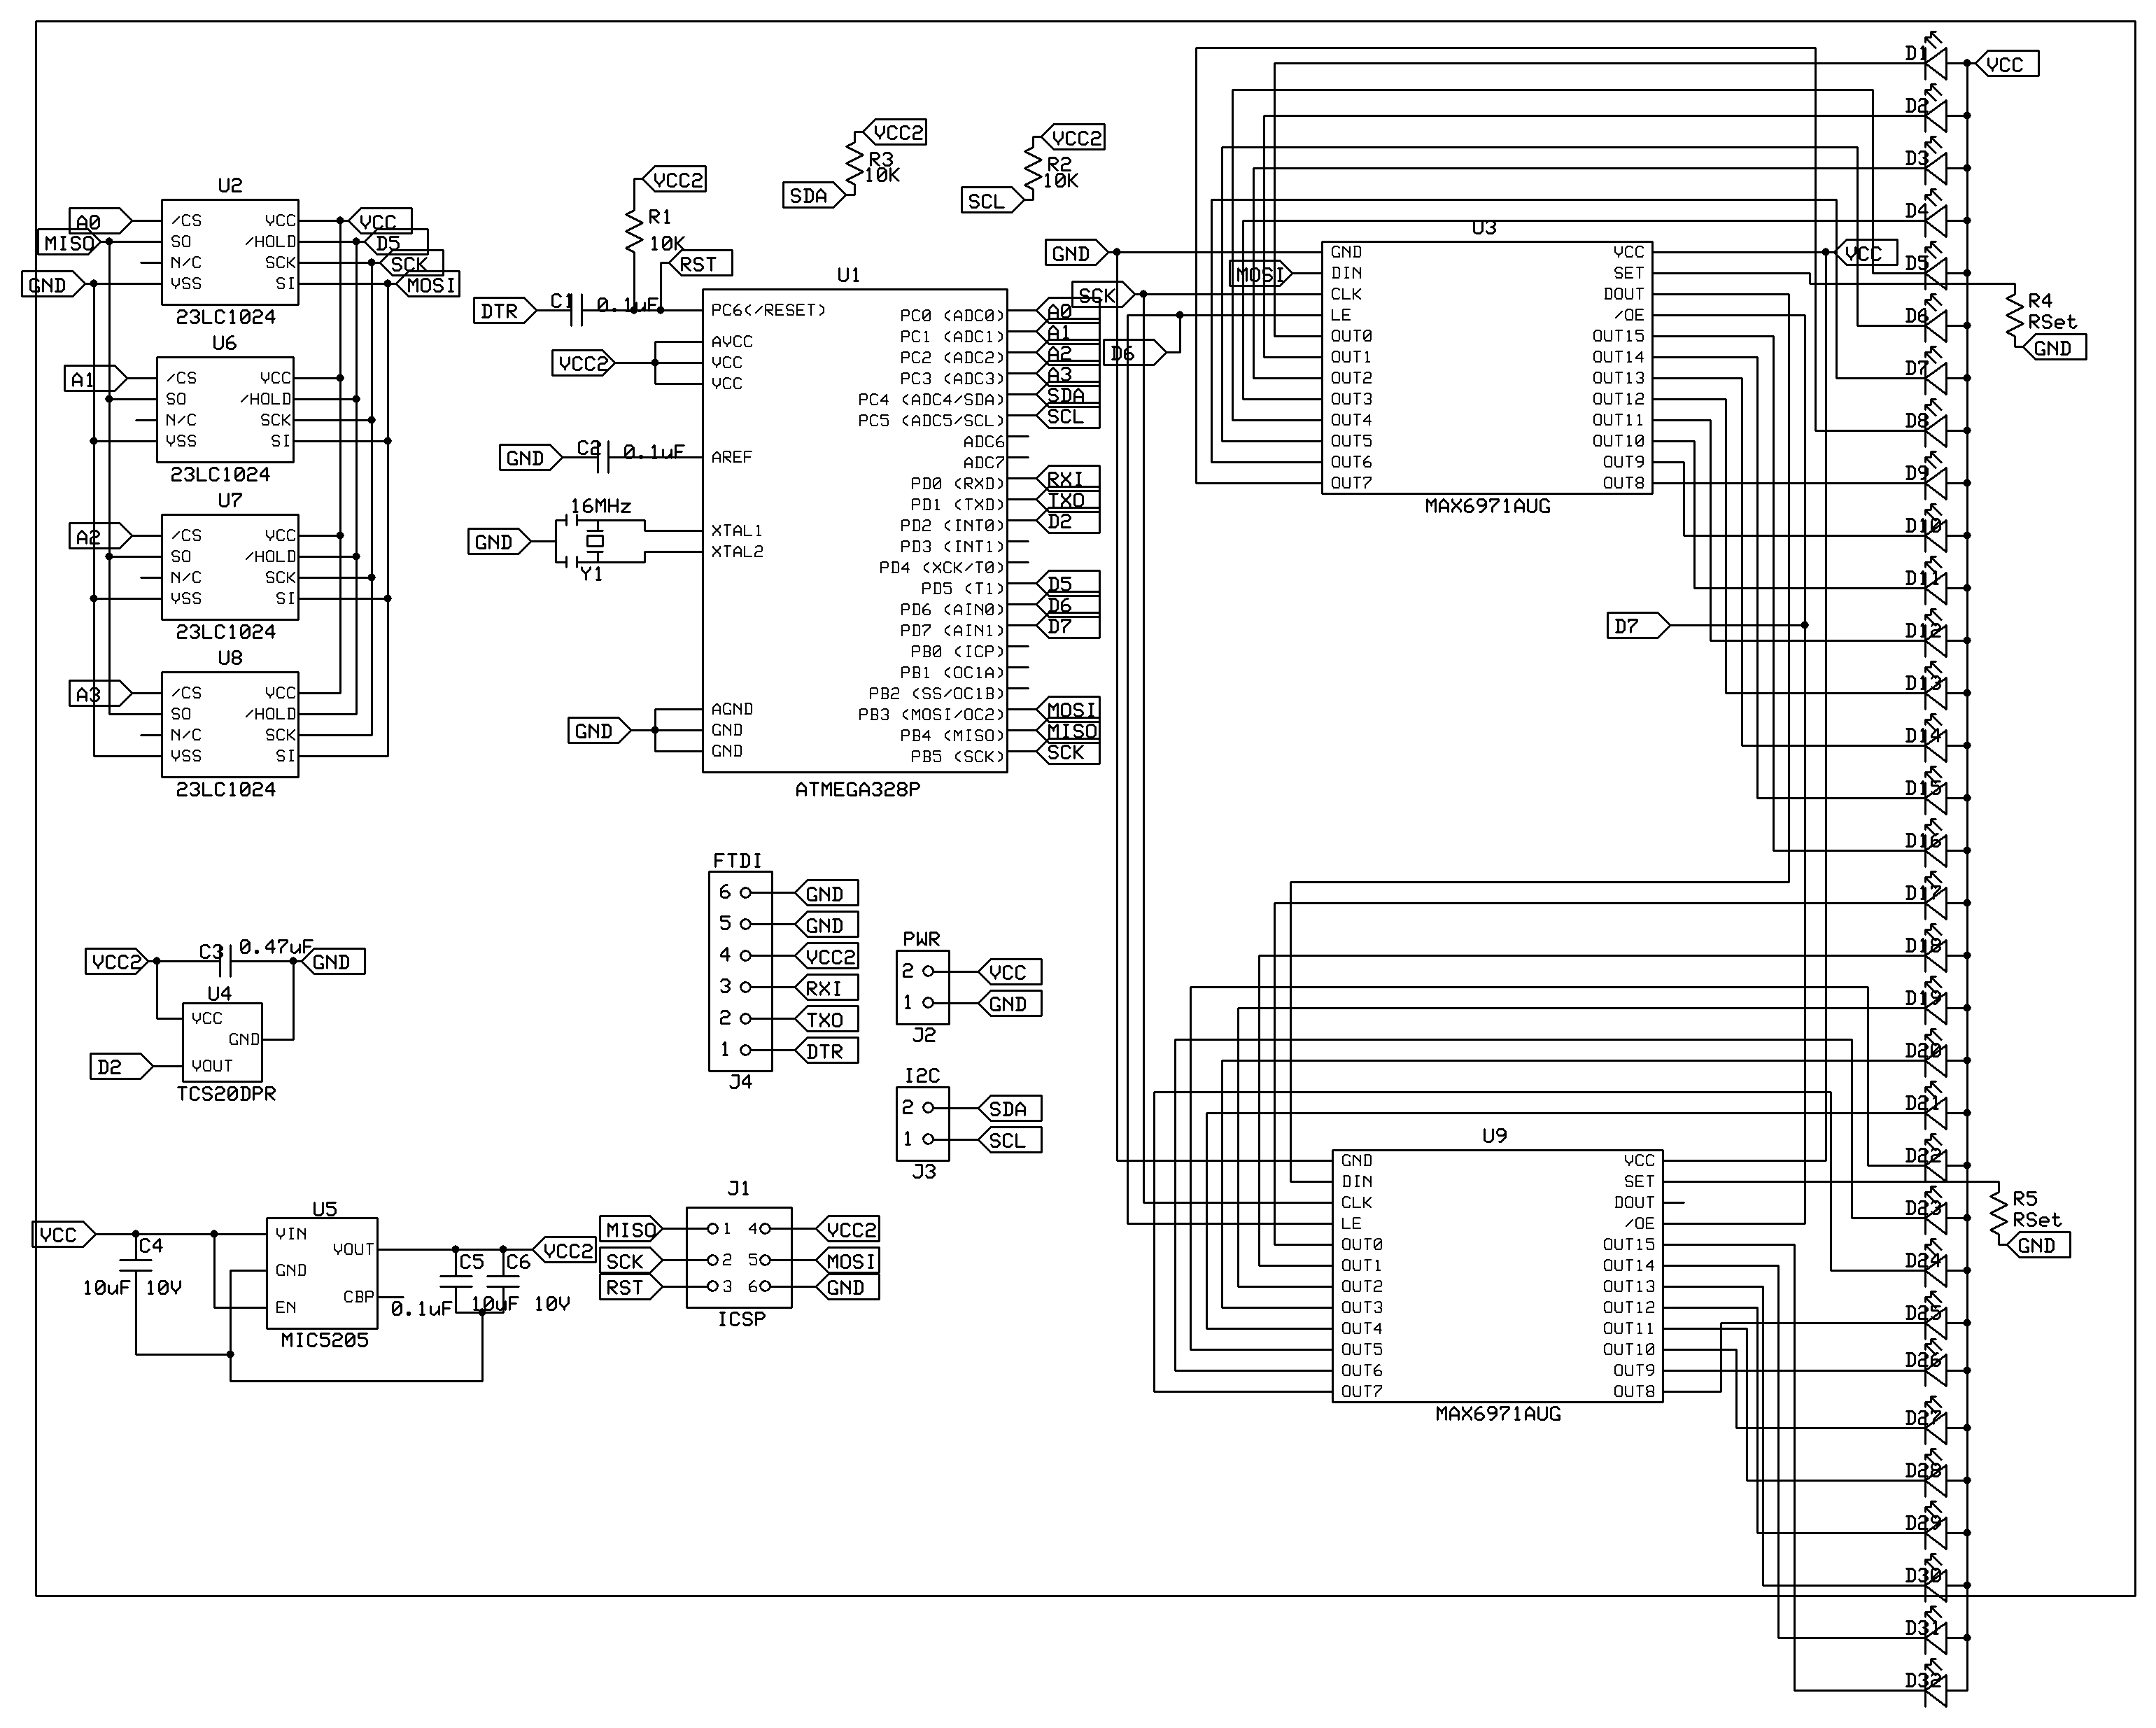
3DPOV - Schematic

Slide 9
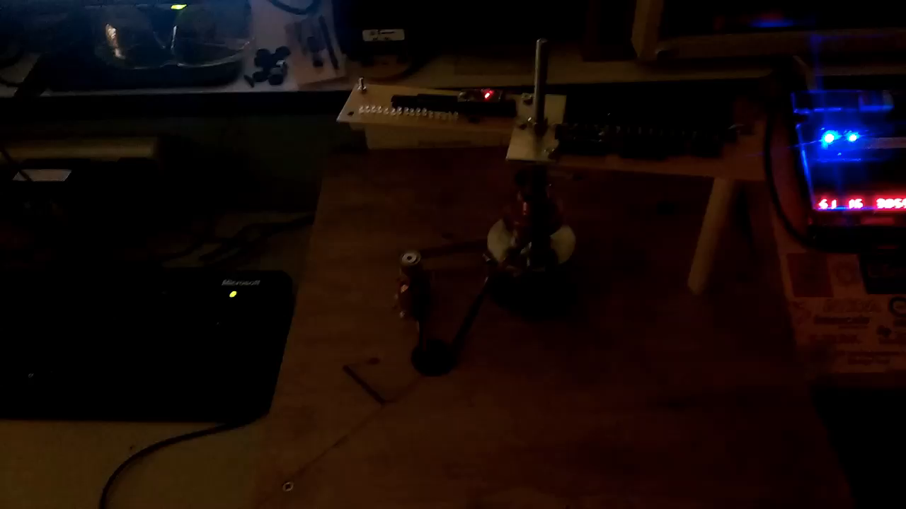
Demo 1 – 16 3mm White LEDs – Gray Code Counter

Slide 10
Demo 2: 8 wing mechanical balancing at 1800 rpm

Slide 11
3DPOV – The road ahead
PCB Printing, soldering of components (Approximately 2-3 Weeks)
Plexiglas enclosure for system – Safety!
More data communication testing
Clean up wooden base – level, clean, stain
More sound dampening
Creating the 3D models, animations

